Slide 1
Brief Bios for
Workshop Participants
DRAFT
Template for adding workshop participants bios
2021

Slide 2
Name
Institutional Affiliation
Research Interest
Something that not many people know about you
TEMPLATE

Slide 3
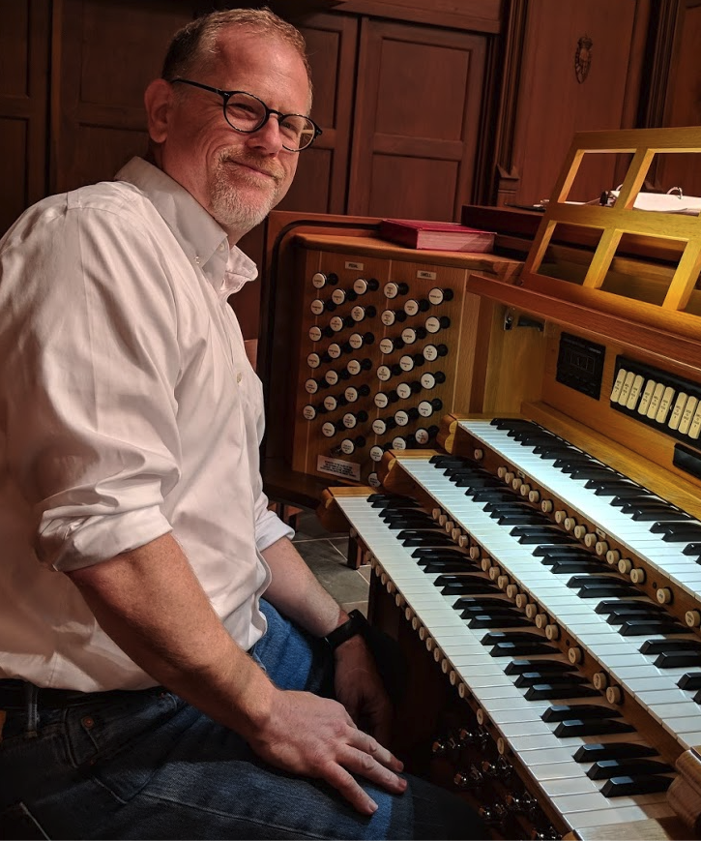
Chris Lenhardt
Institutional Affiliation
Renaissance Computing Institute (RENCI), University of North Carolina at Chapel Hill
Research Interests
Sociotechnical elements of science information infrastructure
Something not many people know about me
Before covid hit, I was learning to play the pipe organ

Slide 4
Jill
Institutional Affiliation
Research Interest
Something that not many people know about you

Slide 5
Graciela
Institutional Affiliation
Research Interest
Something that not many people know about you

Slide 6
Elaine
Institutional Affiliation
Research Interest
Something that not many people know about you

Slide 7
Lea
Institutional Affiliation
Research Interest
Something that not many people know about you

